Slide 1
William Stallings Computer Organization and Architecture
Chapter 2 Computer Evolution and Performance

Slide 2
ENIAC - background
Electronic Numerical Integrator And Computer
Eckert and Mauchly
University of Pennsylvania
Trajectory tables for weapons
Started 1943
Finished 1946
Too late for war effort
Used until 1955

Slide 3
ENIAC - details
Decimal (not binary)
20 accumulators of 10 digits
Programmed manually by switches
18,000 vacuum tubes
30 tons
15,000 square feet
140 kW power consumption
5,000 additions per second

Slide 4
von Neumann/Turing
Stored Program concept
Main memory storing programs and data
ALU operating on binary data
Control unit interpreting instructions from memory and executing
Input and output equipment operated by control unit
Princeton Institute for Advanced Studies
IAS
Completed 1952

Slide 5
Structure of von Nuemann machine
Arithmetic and Logic Unit
Input
Output
Equipment
Main
Memory
Program Control Unit

Slide 6
IAS - details
1000 x 40 bit words
Binary number
2 x 20 bit instructions
Set of registers (storage in CPU)
Memory Buffer Register
Memory Address Register
Instruction Register
Instruction Buffer Register
Program Counter
Accumulator
Multiplier Quotient

Slide 7
Structure of IAS - detail
Central Processing Unit
Arithmetic and Logic Unit
Accumulator
MQ
Arithmetic & Logic Circuits
Input
Output
Equipment
MBR
Instructions
& Data
Main
Memory
IBR
PC
MAR
IR
Control
Circuits
Program Control Unit
Address

Slide 8
Commercial Computers
1947 - Eckert-Mauchly Computer Corporation
UNIVAC I (Universal Automatic Computer)
US Bureau of Census 1950 calculations
Became part of Sperry-Rand Corporation
Late 1950s - UNIVAC II
Faster
More memory

Slide 9
IBM
Punched-card processing equipment
1953 - the 701
IBM’s first stored program computer
Scientific calculations
1955 - the 702
Business applications
Lead to 700/7000 series

Slide 10
Transistors
Replaced vacuum tubes
Smaller
Cheaper
Less heat dissipation
Solid State device
Made from Silicon (Sand)
Invented 1947 at Bell Labs
William Shockley et al.

Slide 11
Transistor Based Computers
Second generation machines
NCR & RCA produced small transistor machines
IBM 7000
DEC - 1957
Produced PDP-1

Slide 12
Microelectronics
Literally - “small electronics”
A computer is made up of gates, memory cells and interconnections
These can be manufactured on a semiconductor
e.g. silicon wafer

Slide 13
Generations of Computer
Vacuum tube - 1946-1957
Transistor - 1958-1964
Small scale integration - 1965 on
Up to 100 devices on a chip
Medium scale integration - to 1971
100-3,000 devices on a chip
Large scale integration - 1971-1977
3,000 - 100,000 devices on a chip
Very large scale integration - 1978 to date
100,000 - 100,000,000 devices on a chip
Ultra large scale integration
Over 100,000,000 devices on a chip

Slide 14
Moore’s Law
Increased density of components on chip
Gordon Moore - cofounder of Intel
Number of transistors on a chip will double every year
Since 1970’s development has slowed a little
Number of transistors doubles every 18 months
Cost of a chip has remained almost unchanged
Higher packing density means shorter electrical paths, giving higher performance
Smaller size gives increased flexibility
Reduced power and cooling requirements
Fewer interconnections increases reliability

Slide 15
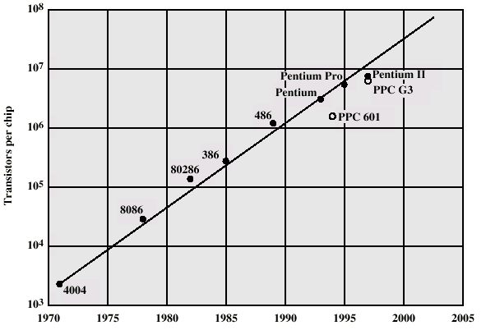
Growth in CPU Transistor Count

Slide 16
IBM 360 series
1964
Replaced (& not compatible with) 7000 series
First planned “family” of computers
Similar or identical instruction sets
Similar or identical O/S
Increasing speed
Increasing number of I/O ports (i.e. more terminals)
Increased memory size
Increased cost
Multiplexed switch structure

Slide 17
DEC PDP-8
1964
First minicomputer (after miniskirt!)
Did not need air conditioned room
Small enough to sit on a lab bench
$16,000
$100k+ for IBM 360
Embedded applications & OEM
BUS STRUCTURE

Slide 18
DEC - PDP-8 Bus Structure
Console
Controller
Main Memory
I/O
Module
I/O
Module
CPU
OMNIBUS

Slide 19
Semiconductor Memory
1970
Fairchild
Size of a single core
i.e. 1 bit of magnetic core storage
Holds 256 bits
Non-destructive read
Much faster than core
Capacity approximately doubles each year

Slide 20
Intel
1971 - 4004
First microprocessor
All CPU components on a single chip
4 bit
Followed in 1972 by 8008
8 bit
Both designed for specific applications
1974 - 8080
Intel’s first general purpose microprocessor

Slide 21
Speeding it up
Pipelining
On board cache
On board L1 & L2 cache
Branch prediction
Data flow analysis
Speculative execution

Slide 22
Performance Mismatch
Processor speed increased
Memory capacity increased
Memory speed lags behind processor speed

Slide 23
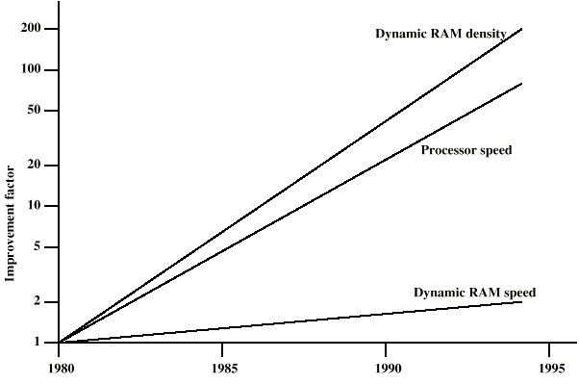
DRAM and Processor Characteristics

Slide 24
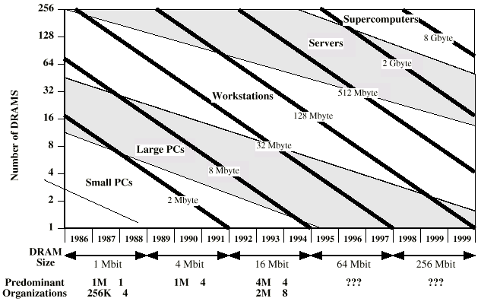
Trends in DRAM use

Slide 25
Solutions
Increase number of bits retrieved at one time
Make DRAM “wider” rather than “deeper”
Change DRAM interface
Cache
Reduce frequency of memory access
More complex cache and cache on chip
Increase interconnection bandwidth
High speed buses
Hierarchy of buses

